Slide 1
Collaborative Filtering
Architecture of Collaborative Filtering,
User-based nearest neighbour recommendation,
Item-based nearest neighbour recommendation,
Model based and pre-processing based approaches,
Clustering for recommendation system,
Attacks on collaborative recommender systems,
Advantages and drawbacks of Collaborative Filtering.

Slide 2
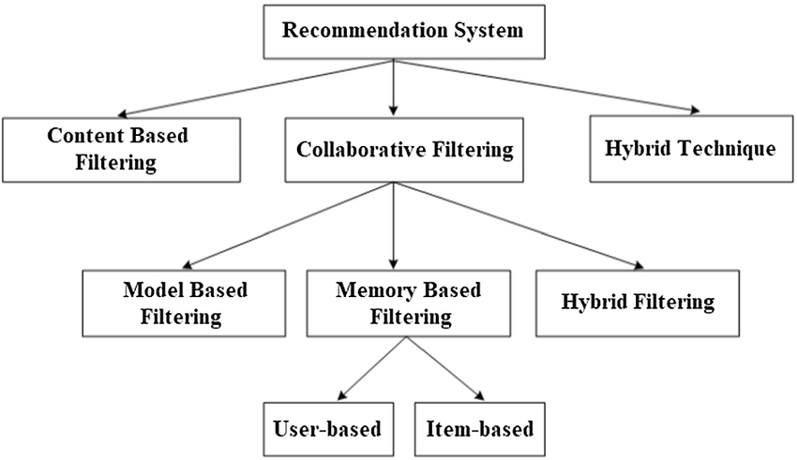
Neighborhood-based collaborative filtering algorithm

Slide 3
Neighborhood-based collaborative filtering algorithm
1. User-based collaborative filtering: In this case, the ratings provided by similar users to a target user A are used to make recommendations for A. The predicted ratings of A are computed as the weighted average values of these “peer group” ratings for each item.
2. Item-based collaborative filtering: In order to make recommendations for target item B, the first step is to determine a set S of items, which are most similar to item B. Then, in order to predict the rating of any particular user A for item B, the ratings in set S, which are specified by A, are determined. The weighted average of these ratings is used to compute the predicted rating of user A for item B.
Ratings are predicted using the ratings of neighboring users,
similarities among users (rows of ratings matrix),
Ratings are predicted using the user’s own ratings on neighboring (i.e., closely related) items

Slide 4
we assume that the user-item ratings matrix is an incomplete m × n matrix
R = [ruj ] containing m users and n items.
ratings matrix is denoted by R, and it is an m × n matrix containing m users and n items. Therefore, the rating of user u for item j is denoted by [ruj ]

Slide 5
Neighborhood-based collaborative filtering algorithms can be formulated in one of two ways:
1. Predicting the rating value of a user-item combination: This is the simplest and most primitive formulation of a recommender system. In this case, the missing rating ruj of the user u for item j is predicted.
2. Determining the top-k items or top-k users: In most practical settings, the merchant is not necessarily looking for specific ratings values of user-item combinations. Rather, it is more interesting to learn the top-k most relevant items for a particular user, or the top-k most relevant users for a particular item. The problem of determining the top-k items is more common than that of finding the top-k users.

Slide 6
Ratings
1. Continuous ratings: Jester joke recommendation engine values -10-+10
The drawback of this approach is that it creates a burden on the user of having to think of a real value from an infinite number of possibilities. Therefore, such an approach is relatively rare
2. Interval-based ratings: numerical integer values from 1 to 5, from -2 to 2, or from 1 to 7. An important assumption is that the numerical values explicitly define the distances between the ratings, and the rating values are typically equidistant
3. Ordinal ratings: “Strongly Disagree,” “Disagree,” “Neutral,” “Agree,” and “Strongly Agree.”
4. Binary ratings: like or dislike : you tube
5. Unary ratings: like : facebook

Slide 7
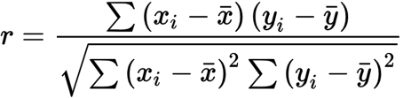
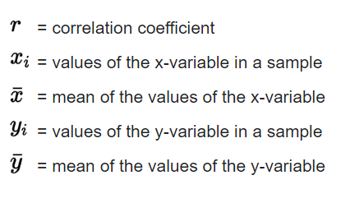
Pearson correlation coefficient

Slide 8

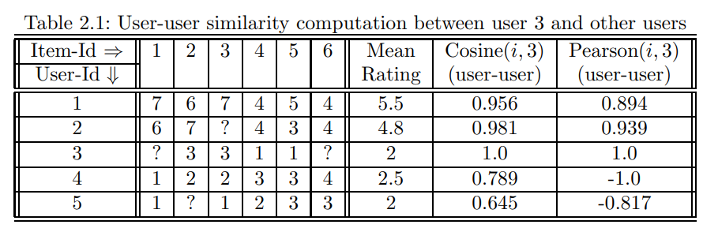
Predicting Ratings with Neighborhood-Based Methods
User-based models

Slide 9
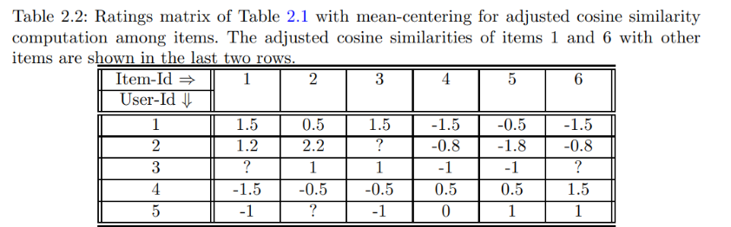
2. Item-based models:

Slide 10
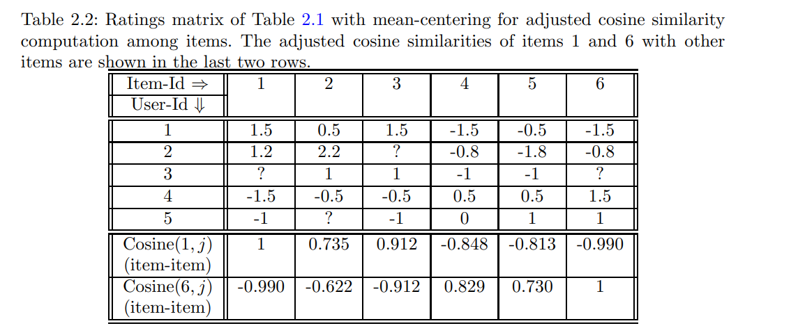
2. Item-based models:

Slide 11
User-Based Neighborhood Models
In order to determine the neighborhood of the target user i, her similarity to all the other users is computed. Therefore, a similarity function needs to be defined between the ratings specified by users. Such a similarity computation is tricky because different users may have different scales of ratings. One user might be biased toward liking most items, whereas another user might be biased toward not liking most of the items. Furthermore, different users may have rated different items. Therefore, mechanisms need to be identified to address these issues.

Slide 12
User-Based Neighborhood Models
I_{u} = {1, 3, 5}.
Therefore, the set of items rated by both users u and v is given by I_{u} ∩ Iv.
For example, if user v has rated the first four items,
then I_{v} = {1, 2, 3, 4}, and I_{u} ∩ I_{v} = {1, 3, 5}∩{1, 2, 3, 4} = {1, 3}
One measure that captures the similarity Sim(u, v) between the rating vectors of two users u and v is the Pearson correlation coefficient. Because Iu ∩Iv represents the set of item indices for which both user u and user v have specified ratings, the coefficient is computed only on this set of items.

Slide 13

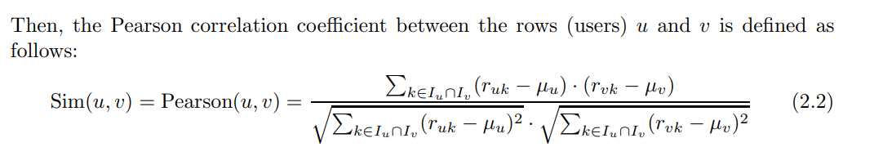
The first step is to compute the mean rating μu for each user u using her specified ratings:
Second step

Slide 14
User-Based Neighborhood Models
The Pearson coefficient is computed between the target user and all the other users. One way of defining the peer group of the target user would be to use the set of k users with the highest Pearson coefficient with the target. However, since the number of observed ratings in the top-k peer group of a target user may vary significantly with the item at hand, the closest k users are found for the target user separately for each predicted item, such that each of these k users have specified ratings for that item

Slide 15

User-Based Neighborhood Models
The main problem with this approach is that different users may provide ratings on different scales. One user might rate all items highly, whereas another user might rate all items negatively. The raw ratings, therefore, need to be mean-centered in row-wise fashion, before determining the (weighted) average rating of the peer group. The mean-centered rating suj of a user u for item j is defined by subtracting her mean rating from the raw rating ruj .

Slide 16
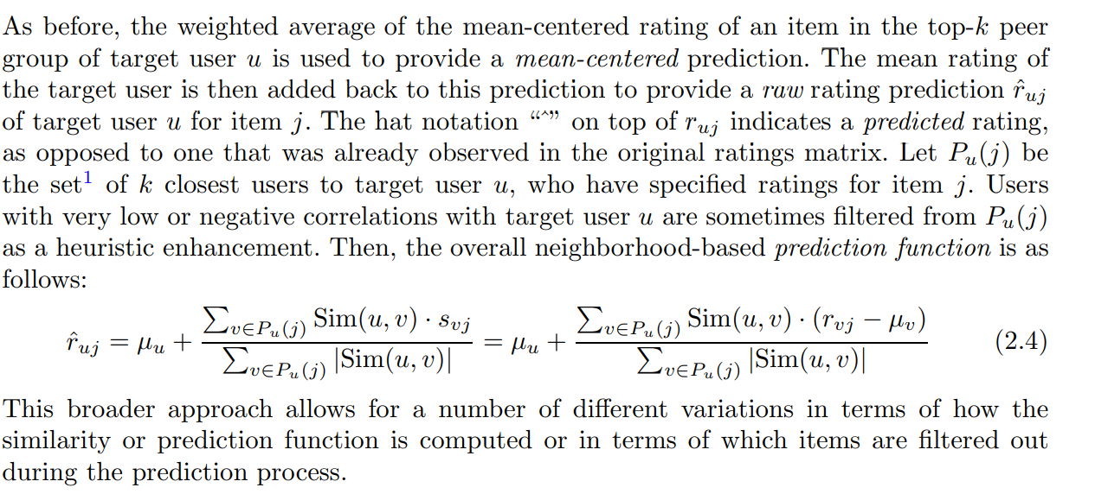

Slide 17
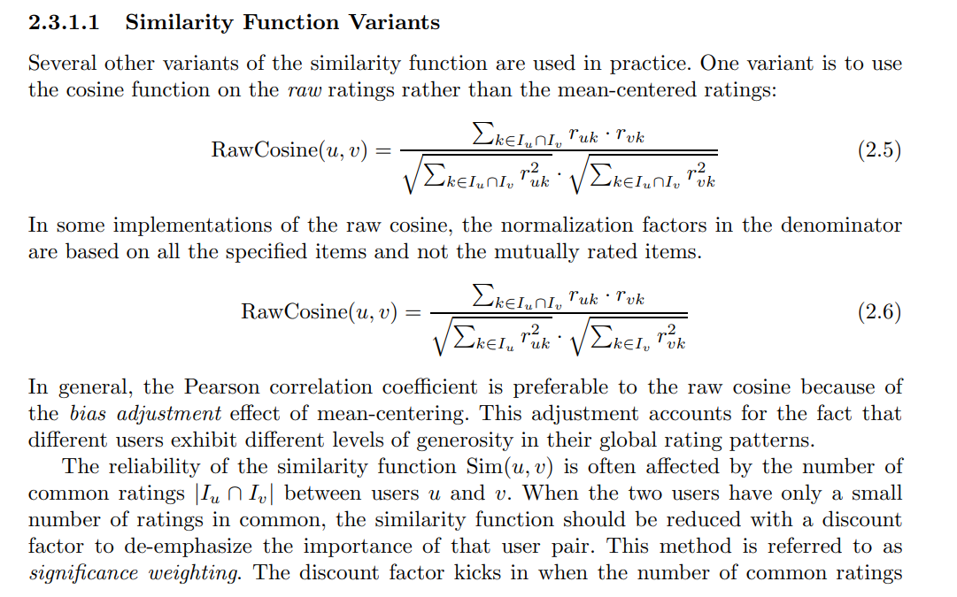

Slide 18
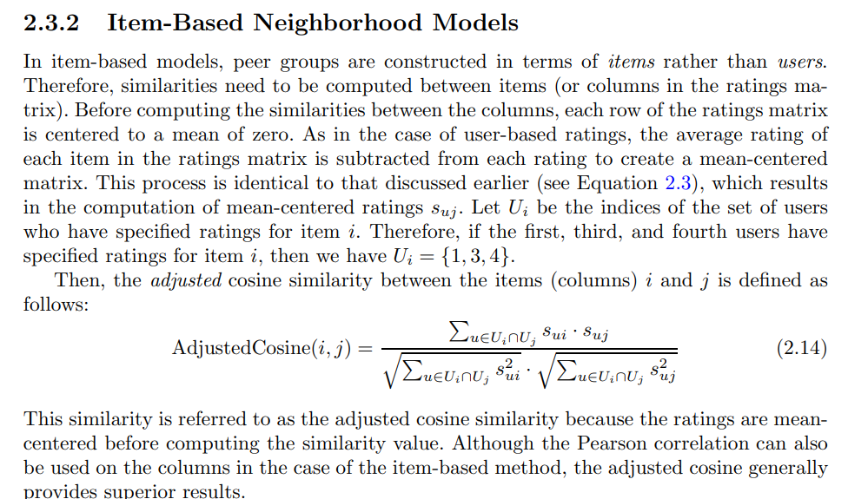

Slide 19
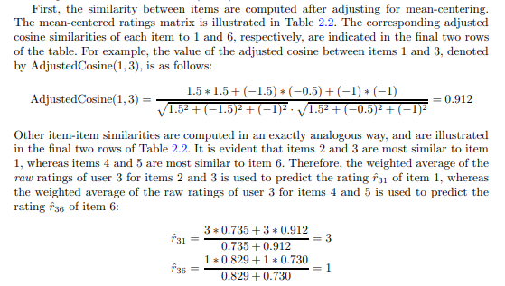

Slide 20
Efficient Implementation and Computational Complexity
Neighborhood-based methods are always used to determine the best item recommendations for a target user or the best user recommendations for a target item.
Neighborhood-based methods are always partitioned into an offline phase and an online phase.
In the offline phase, the user-user (or item-item) similarity values and peer groups of the users (or items) are computed. For each user (or item), the relevant peer group is prestored on the basis of this computation. In the online phase, these similarity values and peer groups are leveraged to make predictions with the use of relationships

Slide 21
Time and space complexity
In the case of user-based methods, the process of determining the peer group of a target user may require O(m·n` ) time. Therefore, the offline running time for computing the peer groups of all users is given by O(m² · n`). For item-based methods, the corresponding offline running time is given by O(n² · m`).
the space requirements of user-based methods are O(m²), whereas the space requirements of item-based methods are O(n²). Because the number of users is typically greater than the number of items, the space requirements of user-based methods are generally greater than those of item-based methods.

Slide 22
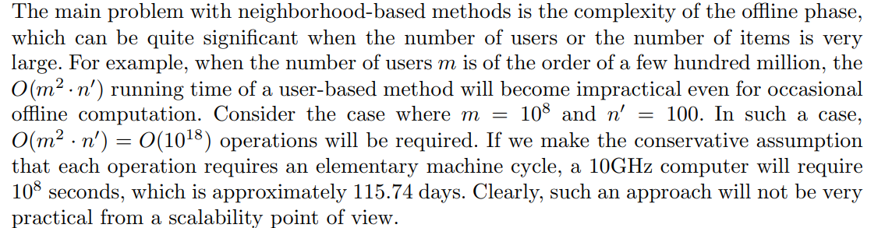
Clustering and Neighborhood-Based Methods

Slide 23
clustering-based methods
The main idea of clustering-based methods is to replace the offline nearest-neighbor computation phase with an offline clustering phase. Just as the offline nearest-neighbor phase creates a large number of peer groups, which are centered at each possible target, the clustering process creates a smaller number of peer groups which are not necessarily centered at each possible target. The process of clustering is much more efficient than the O(m² · n`) time required for construction of the peer groups of every possible target. Once the clusters have been constructed, the process of predicting ratings is similar to the approach used in Equation

Slide 24
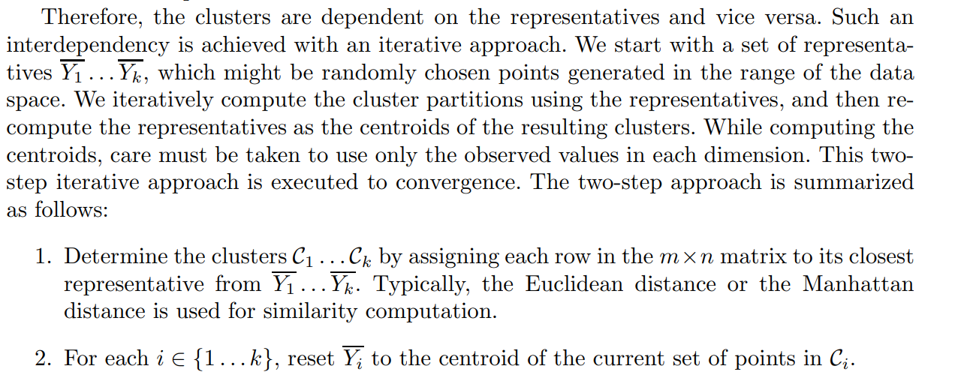

Slide 25
Model-Based Collaborative Filtering
Decision and Regression trees
Rule based collaborative filtering
Naive Baise collaborative filtering
Using an Arbitrary Classification Model as a Black-Box .
Latent Factor Models .

Slide 26
Decision and Regression Trees
Decision and regression trees are frequently used in data classification. Decision trees are designed for those cases in which the dependent variable is categorical, whereas regression trees are designed for those cases in which the dependent variable is numerical. Before discussing the generalization of decision trees to collaborative filtering, we will first discuss the application of decision trees to classification

Slide 27
Decision and Regression Trees
the decision tree produces lists of recommended items at its leaf nodes, instead of single items. This leads to reduced amount of search, when using the tree to compile a recommendation list for a user and consequently enables a scaling of the recommendation system.
Algorithm
The decision tree forms a predictive model which maps the input to a predicted value based on the input’s attributes. Each interior node in the tree corresponds to an attribute and each arc from a parent to a child node represents a possible value or a set of values of that attribute.

Slide 28
algo…
The construction of the tree begins with a root node and the input set. An attribute is assigned to the root and arcs and sub-nodes for each set of values are created.
The input set is then split by the values so that each child node receives only the part of the input set which matches the attribute value as specified by the arc to the child node.
The process then repeats itself recursively for each child until splitting is no longer feasible.

Slide 29
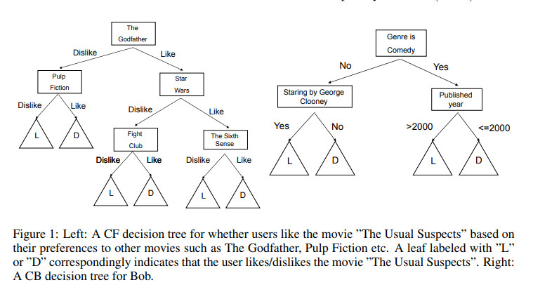

Slide 30
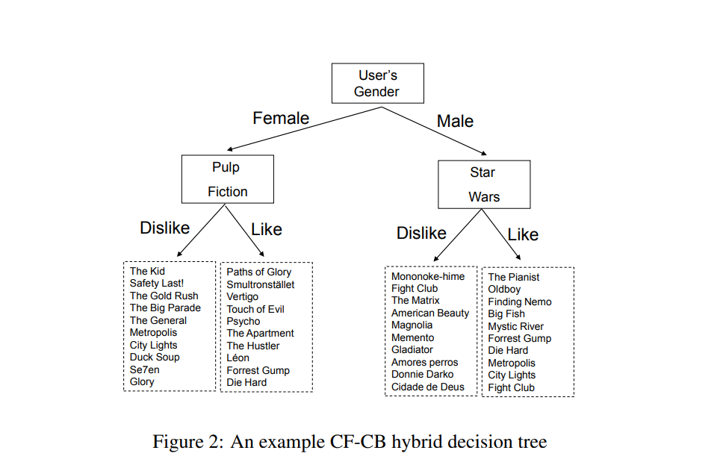

Slide 31
Consider the case in which we have an m×n matrix R. Without loss of generality, assume that the first (n − 1) columns are the independent variables, and the final column is the dependent variable. For ease in discussion, assume that all variables are binary. Therefore, we will discuss the creation of a decision tree rather than a regression tree

Slide 32
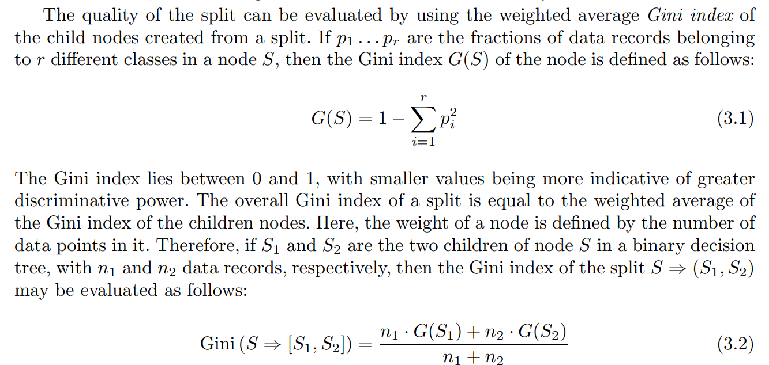

Slide 33
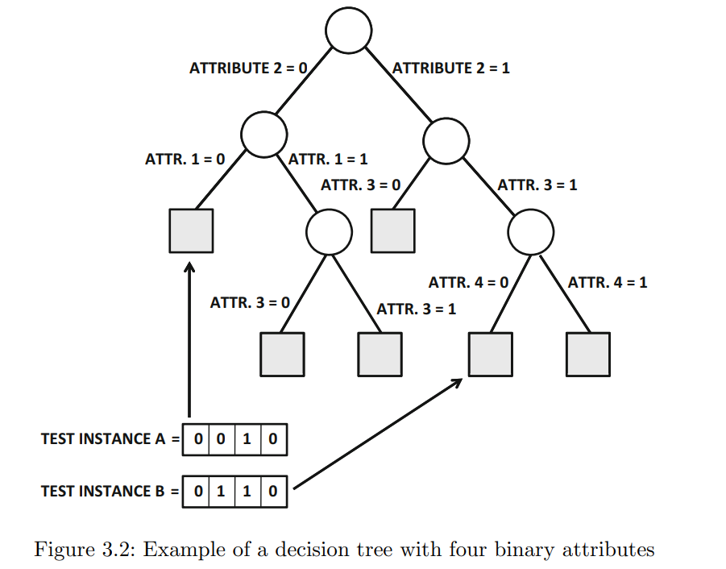

Slide 34
Weakness
A major weakness in using decision trees as a prediction model in RS is the need to build a huge number of trees (either for each item or for each user).
Moreover, the model can only compute the expected rating of a single item at a time. To provide recommendations to the user, we must traverse the tree(s) from root to leaf once for each item in order to compute its predicted rating.
Only after computing the predicted rating of all items can the RS provide the recommendations (highest predicted rating items). Thus decision trees in RS do not scale well with respect to the number of items.

Slide 35
The main challenge in extending decision trees to collaborative filtering is that the predicted entries and the observed entries are not clearly separated in column-wise fashion as feature and class variables. Furthermore, the ratings matrix is very sparsely populated, where the majority of entries are missing. This creates challenges in hierarchically partitioning the training data during the tree-building phase.

Slide 36
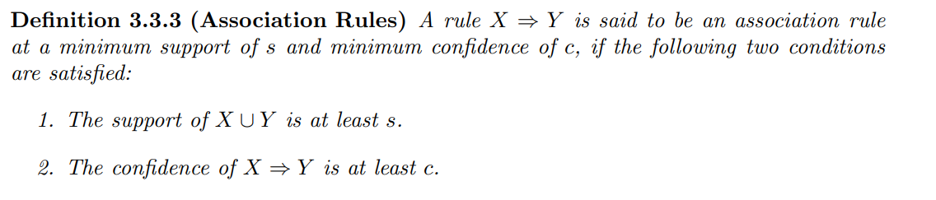
Rule-Based Collaborative Filtering
The relationship between association rules and collaborative filtering is a natural one because the association rule problem was first proposed in the context of discovering relationships between supermarket data.

Slide 37
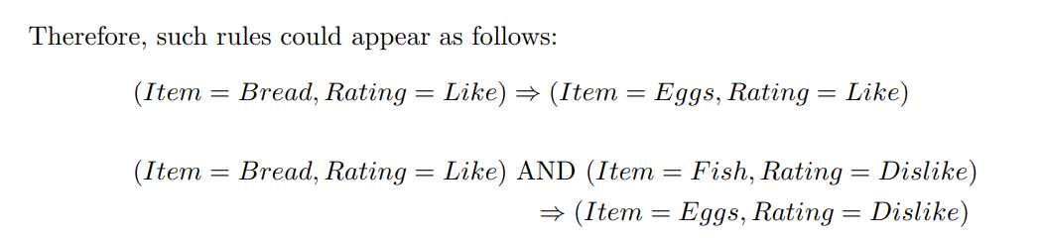

Slide 38
Naive Bayes Collaborative Filtering
We will assume that there are a small number of distinct ratings, each of which can be treated as a categorical value. Therefore, the orderings among the ratings will be ignored in the following discussion. For example, three ratings, such as Like, Neutral, and Dislike, will be treated as unordered discrete values. In the case where the number of distinct ratings is small, such an approximation can be reasonably used without significant loss in accuracy.
The naive Bayes model is a generative model, which is commonly used for classification.

Slide 39
Assume that there are l distinct values of the ratings, which are denoted by v1 ...vl. As in the case of the other models discussed in this chapter, we assume that we have an m × n matrix R containing the ratings of m users for n items. The (u, j)th entry of the matrix is denoted by r_{uj} .

Slide 40
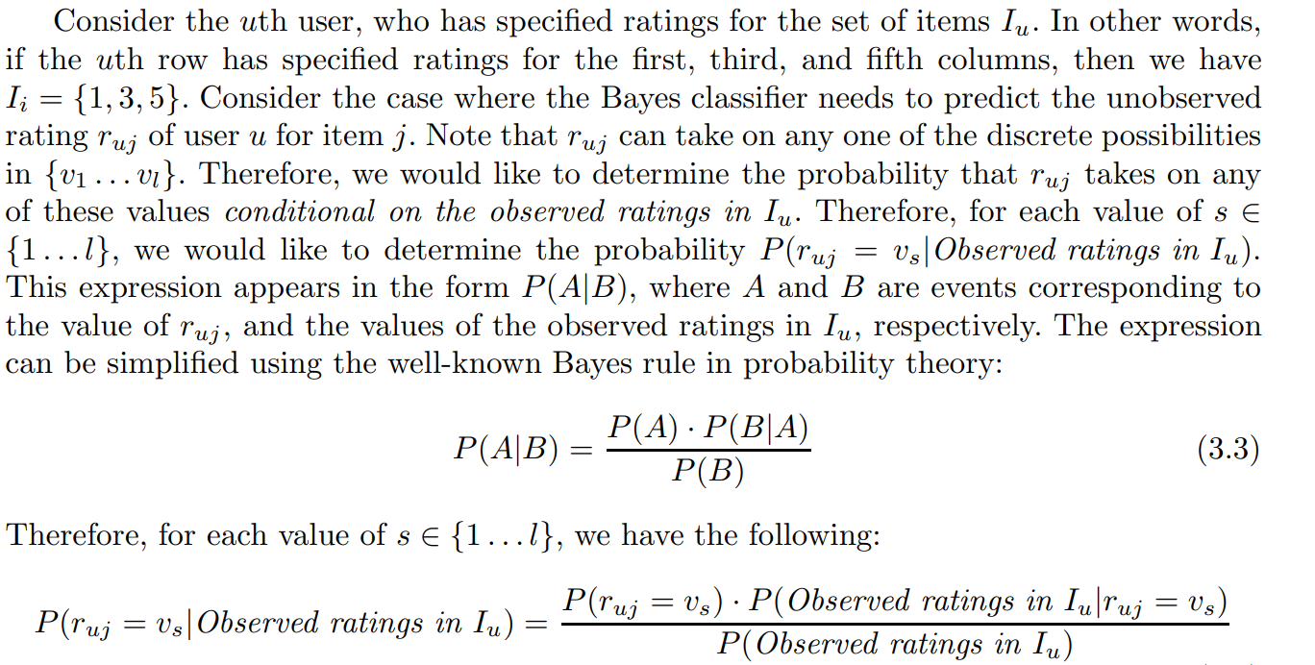

Slide 41
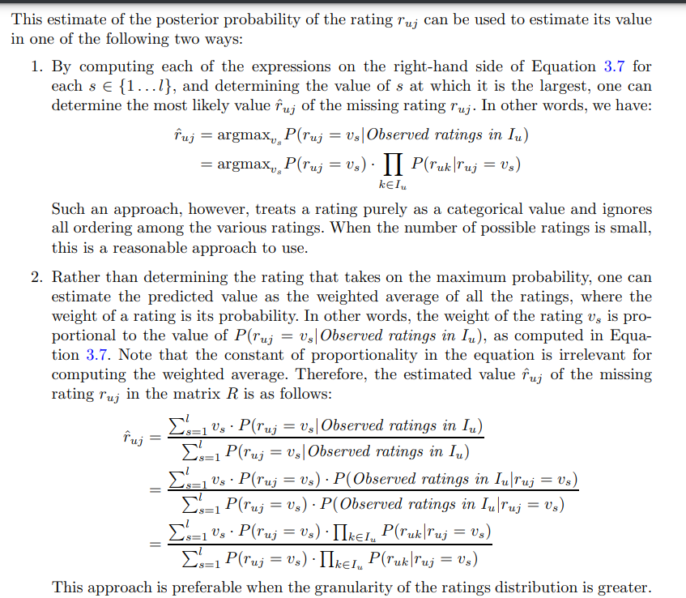

Slide 42
pre-processing based approaches,
1. (Iterative step 1): Use algorithm A to estimate the missing entries of each column by setting it as the target variable and the remaining columns as the feature variables. For the remaining columns, use the current set of filled in values to create a complete matrix of feature variables. The observed ratings in the target column are used for training, and the missing ratings are predicted.
2. (Iterative step 2): Update all the missing entries based on the prediction of algorithm A on each target column.

Slide 43
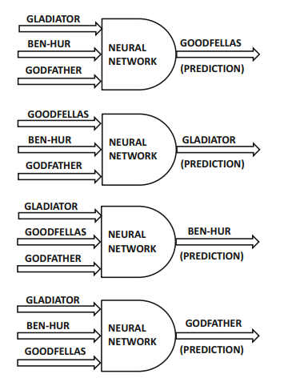

Slide 44
Consider an arbitrary classification/regression modeling algorithm A, which is designed to work with a completely specified matrix.
The first step is to initialize the missing entries in the matrix with row averages, column averages, or with any simple collaborative filtering algorithm.
For example, one might use a simple user-based algorithm for the initialization process. As an optional enhancement, one might center each row of the ratings matrix as a preprocessing step to remove user bias.
In this case, the bias of each user needs to be added back to the predicted values in a post-processing phase. Removing user bias during pre-processing often makes the approach more robust. If the user bias is removed, then the missing entries are always filled in with row averages, which are 0. These simple initializations and bias removal methods will still lead to prediction bias, when one attempts to use the artificially filled in values as training data. Then, the bias in the predicted entries can be iteratively reduced by using the following two-step iterative approach:

Slide 45
Latent factor models
Latent factor models are considered to be state-of-the-art in recommender systems. These models leverage well-known dimensionality reduction methods to fill in the missing entries. Dimensionality reduction methods are used commonly in other areas of data analytics to represent the underlying data in a small number of dimensions.
The key idea in dimensionality reduction methods is that the reduced, rotated, and completely specified representation can be robustly estimated from an incomplete data matrix.

Slide 46
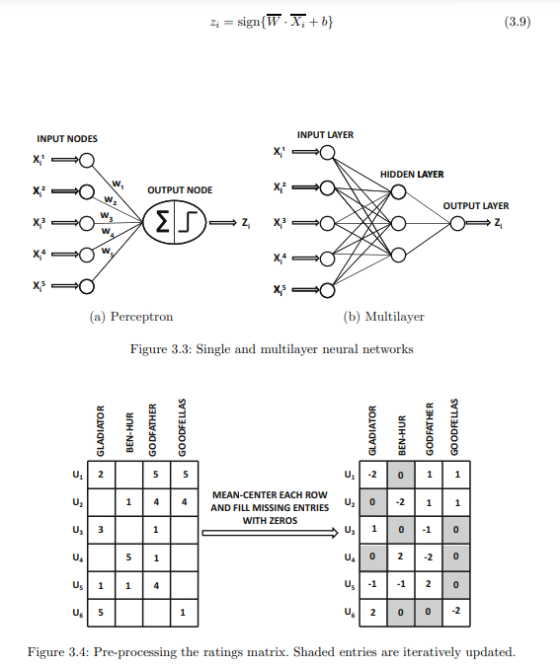
Using a Neural Network
as a Black-Box
b is bias

Slide 47
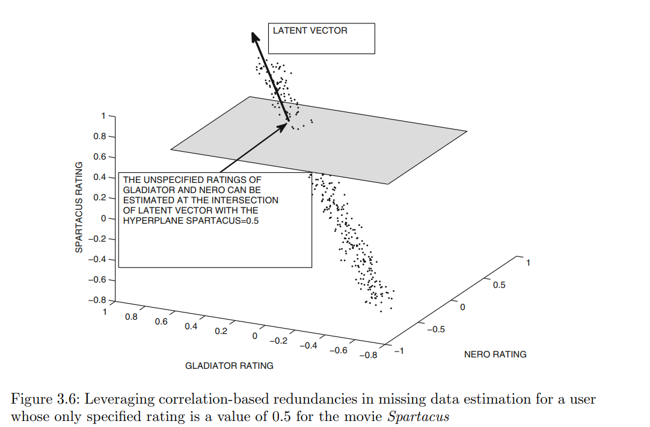

Slide 48
ATTACKS
incorrect feedback about items for personal gain or for malicious reasons:
• The manufacturer of an item or the author of a book might submit fake (positive) reviews on Amazon in order to maximize sales. Such attacks are also referred to as product push attacks.
• The competitor of an item manufacturer might submit malicious reviews about the item. Such attacks are also referred to as nuke attacks.
By creating a concerted set of fake feedbacks from many different users, it is possible to change the predictions of the recommender system. Such users become shills in the attack process. Therefore, such attacks are also referred to as shilling attacks.

Slide 49
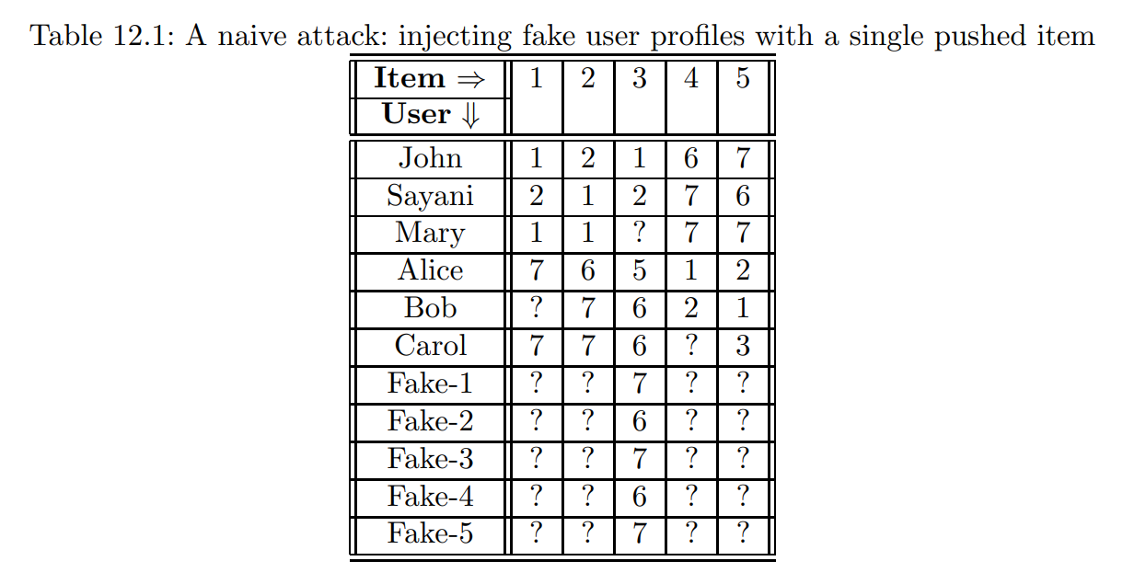

Slide 50
